Slide 1
Software Requirements Specification Template

Slide 2
1. Introduction
Presents an overview of how the SRS is organized and how to use it.
1.1 Purpose
Identify
the product or application
the revision or release number.
If this SRS pertains to only part of a complex system, identify that portion or subsystem.
Describe the different types of reader
such as developers, project managers, marketing staff, users, testers, and documentation writers.
1.2 Document conventions
Describe any standards or typographical conventions used, including the meaning of specific text styles, highlighting, or notations. If you are manually labeling requirements, you might specify the format here for anyone who needs to add one later

Slide 3
1. Introduction
1.3 Project scope
A short description and purpose of the software being specified
If a separate vision and scope or similar document is available, refer to it
An SRS that specifies an incremental release of an evolving product should contain its own scope statement as a subset of the long-term strategic product vision.
Include a high-level summary of the major features the release contains or the significant functions that it performs.
1.4 References
List any documents or other resources to which this SRS refers.

Slide 4
Example – Cafeteria Ordering System
1. Introduction
1.1 Purpose
This SRS describes the functional and nonfunctional requirements for software release 1.0 of the Cafeteria Ordering System (COS). This document is intended to be used by the members of the project team who will implement and verify the correct functioning of the system. Unless otherwise noted, all requirements specified here are committed for release 1.0.
1.2 Document Conventions
No special typographical conventions are used in this SRS.
1.3 Project Scope
The COS will permit Process Impact employees to order meals from the company cafeteria online to be delivered to specified campus locations. A detailed description is available in the Cafeteria Ordering System Vision and Scope Document [1], along with the features that are scheduled for full or partial implementation in this release.
1.4 References
Wiegers, Karl. Cafeteria Ordering System Vision and Scope Document, www.processimpact.com/projects/COS/COS Vision and Scope.docx
Beatty, Joy. Process Impact Intranet Development Standard, Version 1.3, www.processimpact.com/corporate/standards/PI Intranet Development Standard.pdf
Rath, Andrew. Process Impact Internet Application User Interface Standard, Version 2.0, www.processimpact.com/corporate/standards/PI Internet UI Standard.pdf

Slide 5
2. Overall description
2.1 Product perspective
Describe the product’s context and origin. Is it
the next member of a growing product line,
the next version of a mature system,
a replacement for an existing application,
or an entirely new product
If this SRS defines a component of a larger system, state how this software relates to the overall system and identify major interfaces between the two.
Consider including visual models such as a context diagram or ecosystem map (described in Chapter 5) to show the product’s relationship to other systems.

Slide 6
2. Overall description
2.2 User classes and characteristics
Identify the various user classes that you anticipate will use this product, and describe their pertinent characteristics
Some requirements might pertain only to certain user classes. Identify the favored user classes.
User class descriptions are a reusable resource.
If a master user class catalog is available, you can incorporate user class descriptions by simply pointing to them in the catalog instead of duplicating information here.

Slide 7
2. Overall description
2.3 Operating environment
the hardware platform; operating systems and versions;
geographical locations of users, servers, and databases;
organizations that host the related databases, servers, and websites.
List any other software components or applications with which the system must peacefully coexist.
If extensive technical infrastructure work needs to be performed in conjunction with developing the new system, consider creating a separate infrastructure requirements specification

Slide 8
2. Overall description
2.4 Design and implementation constraints
There are times when a certain programming language or a particular code library must be used
Describe any factors that will restrict the options available to the developers and the rationale for each constraint.
Requirements that incorporate or are written in the form of solution ideas rather than needs are imposing design constraints, often unnecessarily, so watch out for those.

Slide 9
2. Overall description
2.5 Assumptions and dependencies
An assumption is a statement that is believed to be true in the absence of proof or definitive knowledge.
Problems can arise if assumptions are incorrect, are obsolete, are not shared, or change, so certain assumptions will translate into project risks. The assumptions to include here are those related to system functionality; business-related assumptions appear in the vision and scope document, as described in Chapter 5.
Identify any dependencies the project or system being built has on external factors or components outside its control.

Slide 10
Example – Cafeteria Ordering System
2. Overall Description
2.1 Product Perspective
The Cafeteria Ordering System is a new software system that replaces the current manual and telephone processes for ordering and picking up meals in the Process Impact cafeteria. The context diagram in Figure C-2 illustrates the external entities and system interfaces for release 1.0. The system is expected to evolve over several releases, ultimately connecting to the Internet ordering services for several local restaurants and to credit and debit card authorization services.

Slide 11
Context diagram for release 1.0 of the Cafeteria Ordering System.

Slide 12
Example – Cafeteria Ordering System
2.3 Operating Environment
OE-1: The COS shall operate correctly with the following web browsers: Windows Internet Explorer versions 7, 8, and 9; Firefox versions 12 through 26; Google Chrome (all versions); and Apple Safari versions 4.0 through 8.0.
OE-2: The COS shall operate on a server running the current corporate-approved versions of Red Hat Linux and Apache HTTP Server.
OE-3: The COS shall permit user access from the corporate intranet; from a VPN Internet connection; and by Android, iOS, and Windows smartphones and tablets.
2.4 Design and Implementation Constraints
CO-1: The system’s design, code, and maintenance documentation shall conform to the Process Impact Intranet Development Standard, Version 1.3 [2].
CO-2: The system shall use the current corporate standard Oracle database engine.
CO-3: All HTML code shall conform to the HTML 5.0 standard.
2.5 Assumptions and Dependencies
AS-1: The cafeteria is open for breakfast, lunch, and supper every company business day in which employees are expected to be on site.
DE-1: The operation of the COS depends on changes being made in the Payroll System to accept payment requests for meals ordered with the COS.
DE-2: The operation of the COS depends on changes being made in the Cafeteria Inventory System to update the availability of food items as COS accepts meal orders.

Slide 13
3. System features
In this template functional requirements are organized by system feature, which is just one possible way to arrange them.
One another option can be to organize them with respect to use cases within user classes.
3.x System feature X
State the name of the feature in just a few words, such as “3.1 Spell Check.” Repeat section 3.x with its subsections 3.x.1 and 3.x.2 for each system feature.
3.x.1 Description
Provide a short description of the feature and indicate whether it is of high, medium, or low priority.
Priorities often are dynamic, changing over the course of the project
3.x.2 Functional requirements
Itemize the specific functional requirements associated with this feature.
Uniquely label each functional requirement, as described earlier in this chapter.

Slide 14
Example – Cafeteria Ordering System
3. System Features
3.1 Order Meals from Cafeteria
3.1.1 Description
A cafeteria Patron whose identity has been verified can order meals either to be delivered to a specified company location or to be picked up in the cafeteria. A Patron can cancel or change a meal order if it has not yet been prepared. Priority = High.

Slide 17
3.2 Order Meals from Restaurants
[Details are not provided in this example. Quite a lot of the functionality described under 3.1 Order Meals from Cafeteria could likely be reused, so this section should just specify the additional functionality that addresses the restaurant interface.]
3.3 Create, View, Modify, and Delete Meal Subscriptions
[Details are not provided in this example.]
3.4 Create, View, Modify, and Delete Cafeteria Menus
[Details are not provided in this example.]

Slide 18
4. Data requirements
Information systems provide value by manipulating data.
Use this section of the template to describe various aspects of the data that the system will consume as inputs, process in some fashion, or create as outputs
4.1 Logical data model
A data model is a visual representation of the data objects and collections the system will process and the relationships between them.
Numerous notations exist for data modeling, including
entity-relationship diagrams
UML class diagrams.
This is not the same thing as an implementation data model that will be realized in the form of database design.
4.2 Data dictionary
The data dictionary defines the composition of data structures and the meaning, data type, length, format, and allowed values for the data elements that make up those structures.
In many cases, you’re better off storing the data dictionary as a separate artifact, rather than embedding it in the middle of an SRS. That also increases its reusability potential in other projects.

Slide 19
4. Data requirements
4.3 Reports
If your application will generate any reports, identify them here and describe their characteristics.
If a report must conform to a specific predefined layout, you can specify that here as a constraint, perhaps with an example.
4.4 Data acquisition, integrity, retention, and disposal
If relevant, describe how data is acquired and maintained.
State any requirements regarding the need to protect the integrity of the system’s data.
Identify any specific techniques that are necessary, such as backups, checkpointing, mirroring, or data accuracy verification.
State policies the system must enforce for either retaining or disposing of data, including temporary data, metadata, residual data (such as deleted records), cached data, local copies, archives, and interim backups.

Slide 20
Example – Cafeteria Ordering System
Partial Data Model

Slide 21
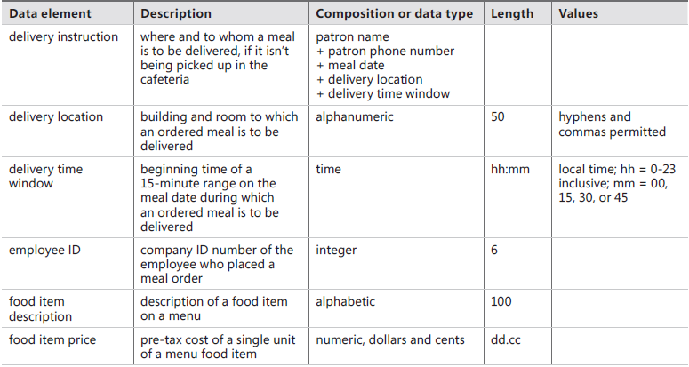
Data Dictionary - Cafeteria Ordering System

Slide 22
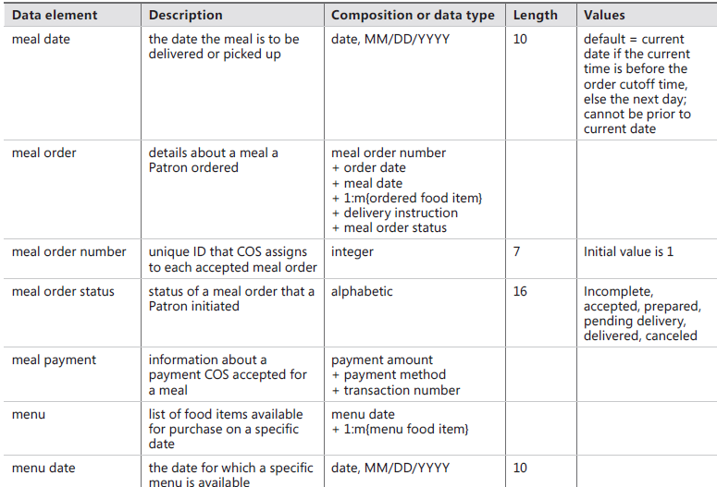
Data Dictionary – Cafeteria Ordering System

Slide 23
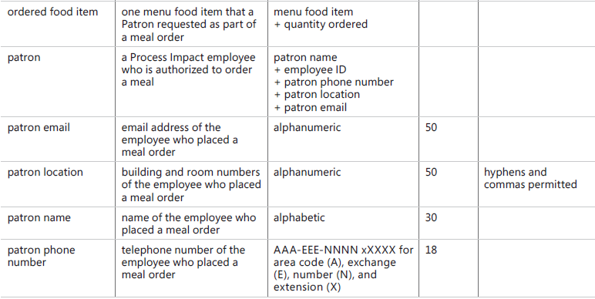
Data Dictionary – Cafeteria Ordering System

Slide 24
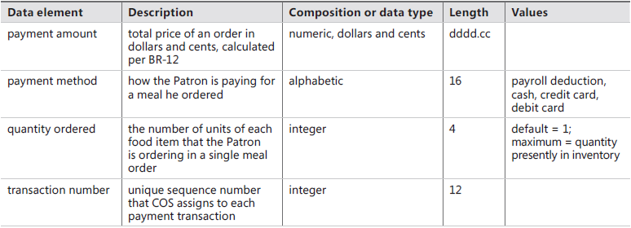
Data Dictionary – Cafeteria Ordering System

Slide 25
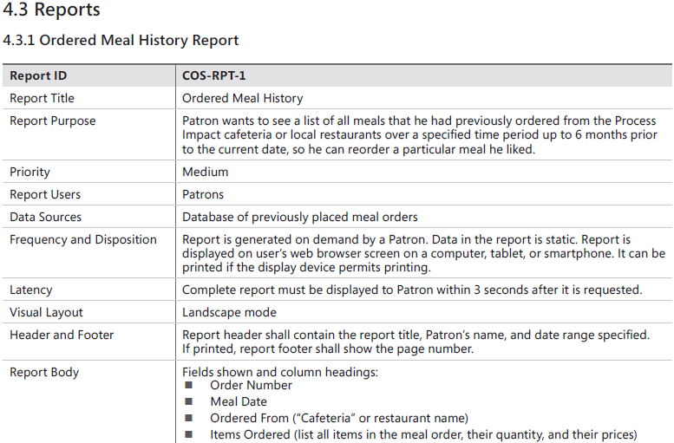
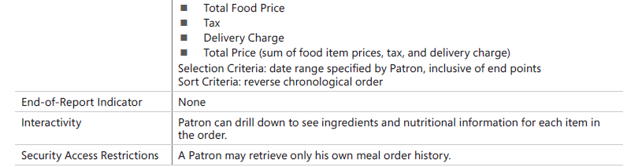

Slide 26
Example – Cafeteria Ordering System
4.4 Data Integrity, Retention, and Disposal
DI-1: The COS shall retain individual Patron meal orders for 6 months following the meal’s delivery date.
DI-2: The COS shall retain menus for 1 year following the menu date.

Slide 27
5. External interface requirements
This section provides information to ensure that the system will communicate properly with users and with external hardware or software elements.
A complex system with multiple subcomponents should create a separate interface specification or system architecture specification.
The

Slide 28
5.1 User interfaces
Describe the logical characteristics of each user interface that the system needs.
Some possible items to address here are:
References to user interface standards or product line style guides that are to be followed
Standards for fonts, icons, button labels, images, color schemes, field tabbing sequences, commonly used controls, branding graphics, copyright and privacy notices, and the like
Screen size, layout, or resolution constraints
Standard buttons, functions, or navigation links that will appear on every screen, such as a help button
Shortcut keys
Message display and phrasing conventions
Data validation
Layout standards to facilitate software localization
Accommodations for users who are visually impaired, color blind, or have other limitations

Slide 29
5. External interface requirements
5.2 Software interfaces
Describe the connections between this product and other software components (identified by name and version), including other applications, databases, operating systems, tools, libraries, websites, and integrated commercial components.
State the purpose, formats, and contents of the messages, data, and control values exchanged between the software components.
Specify the mappings of input and output data between the systems and any translations that need to be made for the data to get from one system to the other.
Describe the services needed by or from external software components and the nature of the inter-component communications.
Identify data that will be exchanged between or shared across software components.
Specify nonfunctional requirements affecting the interface, such as service levels for response times and frequencies, or security controls and

Slide 30
External interface requirements
5.3 Hardware interfaces
Describe the characteristics of each interface between the software components and hardware components, if any, of the system
If this information is extensive, consider creating a separate interface specification document.
5.4 Communications interfaces
State the requirements for any communication functions the product will use, including email, web browser, network protocols, and electronic forms.
Define any pertinent message formatting.
Specify communication security and encryption issues, data transfer rates, handshaking, and synchronization mechanisms.
State any constraints around these interfaces, such as whether certain types of email attachments are acceptable or not.

Slide 31
5.1 User Interfaces
UI-1: The Cafeteria Ordering System screen displays shall conform to the Process Impact Internet Application User Interface Standard, Version 2.0 [3].
UI-2: The system shall provide a help link from each displayed webpage to explain how to use that page.
UI-3: The webpages shall permit complete navigation and food item selection by using the keyboard alone, in addition to using mouse and keyboard combinations.

Slide 32
5.2 Software Interfaces
SI-1: Cafeteria Inventory System
SI-1.1: The COS shall transmit the quantities of food items ordered to the Cafeteria Inventory System through a programmatic interface.
SI-1.2: The COS shall poll the Cafeteria Inventory System to determine whether a requested food item is available.
SI-1.3: When the Cafeteria Inventory System notifies the COS that a specific food item is no longer available, the COS shall remove that food item from the menu for the current date.
SI-2: Payroll System
The COS shall communicate with the Payroll System through a programmatic interface for the following operations:
SI-2.1: To allow a Patron to register and unregister for payroll deduction.
SI-2.2: To inquire whether a Patron is registered for payroll deduction.
SI-2.3: To inquire whether a Patron is eligible to register for payroll deduction.
SI-2.4: To submit a payment request for a purchased meal.
SI-2.5: To reverse a previous charge because a patron rejected a meal or wasn’t satisfied with it, or because the meal was not delivered per the delivery instructions.

Slide 33
5.3 Hardware Interface
No hardware interfaces have been identified.
5.4 Communications Interfaces
CI-1: The COS shall send an email or text message (based on user account settings) to the Patron to confirm acceptance of an order, price, and delivery instructions.
CI-2: The COS shall send an email or text message (based on user account settings) to the Patron to report any problems with a meal order or delivery.

Slide 34
6. Quality Attributes
6.1 Usability Requirements
USE-1: The COS shall allow a Patron to retrieve the previous meal ordered with a single interaction.
USE-2: 95% of new users shall be able to successfully order a meal without errors on their first try.
6.2 Performance Requirements
PER-1: The system shall accommodate a total of 400 users and a maximum of 100 concurrent users during the peak usage time window of 9:00 A.M. to 10:00 A.M. local time, with an estimated average session duration of 8 minutes.
PER-2: 95% of webpages generated by the COS shall download completely within 4 seconds from the time the user requests the page over a 20 Mbps or faster Internet connection.
PER-3: The system shall display confirmation messages to users within an average of 3 seconds and a maximum of 6 seconds after the user submits information to the system.
6.3 Security Requirements
SEC-1: All network transactions that involve financial information or personally identifiable information shall be encrypted per BR-33.
SEC-2: Users shall be required to log on to the COS for all operations except viewing a menu.
SEC-3: Only authorized Menu Managers shall be permitted to work with menus, per BR-24.
SEC-4: The system shall permit Patrons to view only orders that they placed
6.4 Safety Requirements
SAF-1: The user shall be able to see a list of all ingredients in any menu items, with ingredients highlighted that are known to cause allergic reactions in more than 0.5 percent of the North American population.

Slide 35
6.5 Availability Requirements
AVL-1: The COS shall be available at least 98% of the time between 5:00 A.M. and midnight local time and at least 90% of the time between midnight and 5:00 A.M. local time, excluding scheduled maintenance windows.
6.6 Robustness Requirements
ROB-1: If the connection between the user and the COS is broken prior to a new order being either confirmed or terminated, the COS shall enable the user to recover an incomplete order and continue working on it.

Slide 36
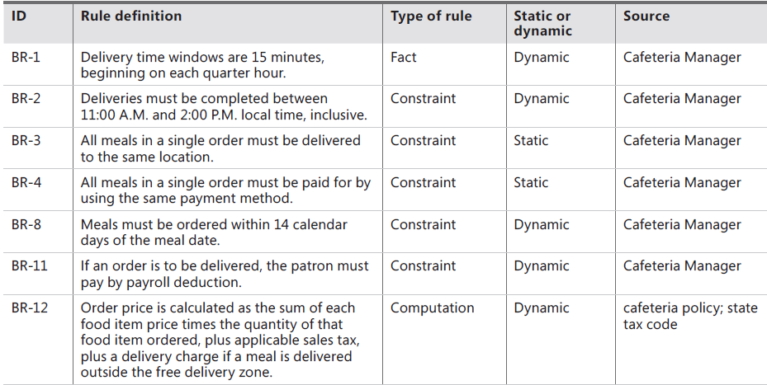
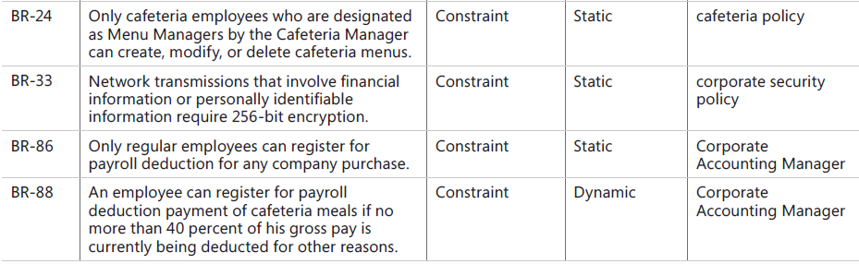

Slide 37
6. Quality attributes
6.1 Usability
Usability requirements deal with ease of learning, ease of use, error avoidance and recovery, efficiency of interactions, and accessibility. The usability requirements specified here will help the user interface designer create the optimum user experience.
6.2 Performance
State specific performance requirements for various system operations. If different functional requirements or features have different performance requirements, it’s appropriate to specify those performance goals right with the corresponding functional requirements, rather than collecting them in this section.
6.3 Security
Specify any requirements regarding security or privacy issues that restrict access to or use of the product. These could refer to physical, data, or software security. Security requirements often originate in business rules, so identify any security or privacy policies or regulations to which the product must conform. If these are documented in a business rules repository, just refer to them.
6.4 Safety
Specify requirements that are concerned with possible loss, damage, or harm that could result from use of the product. Define any safeguards or actions that must be taken, as well as potentially dangerous actions that must be prevented. Identify any safety certifications, policies, or regulations to which the product must conform.
6.x [Others]
Create a separate section in the SRS for each additional product quality attribute to describe characteristics that will be important either to customers or to developers and maintainers. Possibilities include availability, efficiency, installability, integrity, interoperability, modifiability, portability, reliability, reusability, robustness, scalability, and verifiability. Chapter 14 describes a procedure for focusing on those attributes that are of most importance to a particular project.

Slide 38
7. Internationalization and localization requirements
Internationalization and localization requirements ensure that the product will be suitable for use in nations, cultures, and geographic locations other than those in which it was created.
Such requirements might address differences in
currency;
formatting of dates,
numbers, addresses, and telephone numbers;
language, including national spelling conventions within the same language (such as American versus British English), symbols used, and character sets;
given name and family name order; time zones; international regulations and laws; cultural and political issues; paper sizes used; weights and measures; electrical voltages and plug shapes; and many others.
Internationalization and localization requirements could well be reusable across projects.

Slide 39
8. [Other requirements]
Define any other requirements that are not covered elsewhere in the SRS.
Examples are legal, regulatory, or financial compliance and standards requirements; requirements for product installation, configuration, startup, and shutdown; and logging, monitoring, and audit trail requirements.
Instead of just combining these all under “Other,” add any new sections to the template that are pertinent to your project. Omit this section if all your requirements are accommodated in other sections.
Transition requirements that are necessary for migrating from a previous system to a new one could be included here if they involve software being written (as for data conversion programs), or in the project management plan if they do not (as for training development or delivery).

Slide 40
Appendix A: Glossary
Define any specialized terms that a reader needs to know to understand the SRS, including acronyms and abbreviations.
Spell out each acronym and provide its definition.
Consider building a reusable enterprise-level glossary that spans multiple projects and incorporating by reference any terms that pertain to this project.
Each SRS would then define only those terms specific to an individual project that do not appear in the enterprise-level glossary.
Note that data definitions belong in the data dictionary, not the glossary.

Slide 41
Appendix B: Analysis models
This optional section includes or points to pertinent analysis models such as data flow diagrams, feature trees, state-transition diagrams, or entity-relationship diagrams.
Often it’s more helpful for the reader if you incorporate certain models into the relevant sections of the specification instead of collecting them at the end.

Slide 42
Projects following agile development life cycles take a variety of approaches to specifying requirements that differ from the method just described. As you saw in Chapter 8, “Understanding user requirements,” many agile projects employ user stories during elicitation. Each user story is a statement of a user need or functionality that will be valuable to the user or purchaser of the system (Cohn 2004; Cohn 2010). Teams might begin specification on agile projects by writing just enough information for each user story so that the stakeholders have a general understanding of what the story is about and can prioritize it relative to other stories. This allows the team to begin planning allocations of specific stories to iterations. The team might aggregate a group of related stories into a “minimally marketable feature” that needs to be fully implemented prior to a product release so the feature delivers the expected customer value.
User stories are accumulated and prioritized into a dynamic product backlog that evolves throughout the project. Large stories that encompass significant functionality that cannot be implemented within a single iteration are subdivided into smaller stories, which are allocated to multiple iterations for implementation. (See Chapter 20, “Agile projects.”) User stories can be recorded on something as simple

Slide 43
6.1 Usability
Usability requirements deal with ease of learning, ease of use, error avoidance and recovery, efficiency of interactions, and accessibility. The usability requirements specified here will help the user interface designer create the optimum user experience.
6.2 Performance
State specific performance requirements for various system operations. If different functional requirements or features have different performance requirements, it’s appropriate to specify those performance goals right with the corresponding functional requirements, rather than collecting them in this section.
6.3 Security
Specify any requirements regarding security or privacy issues that restrict access to or use of the product. These could refer to physical, data, or software security. Security requirements often originate in business rules, so identify any security or privacy policies or regulations to which the product must conform. If these are documented in a business rules repository, just refer to them.
6.4 Safety
Specify requirements that are concerned with possible loss, damage, or harm that could result from use of the product. Define any safeguards or actions that must be taken, as well as potentially dangerous actions that must be prevented. Identify any safety certifications, policies, or regulations to which the product must conform.
6.x [Others]
Create a separate section in the SRS for each additional product quality attribute to describe characteristics that will be important either to customers or to developers and maintainers. Possibilities include availability, efficiency, installability

